Slide 1
Chapter 18
Classification of Matter
Section 1 – Composition of Matter

Slide 2
Pure Substances
Every material is made up of a pure substance or a mixture of substances.
A pure substance is a type of matter (an element or compound) that cannot be broken down into simpler substances and keep the properties of that substance.
Exs. Helium, Water, Aluminum, Salt
Elements are substances with atoms that are all alike.
Exs. Carbon, Copper, Nitrogen
Compounds are substances made of two or more elements that are combined in a certain proportion.
H₂O (water)
NaCl (table salt)

Slide 3
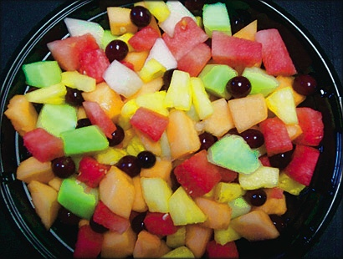
Mixtures
A mixture is a material made up of two or more substances that can be easily separated.
There are two types of mixtures:
Heterogeneous Mixtures – A mixture in which different materials can be easily distinguished.
Exs. Granite, concrete, dry soup mix
Homogeneous Mixtures – A mixture containing two or more gaseous, liquid or solid substances blended evenly throughout.

Slide 4
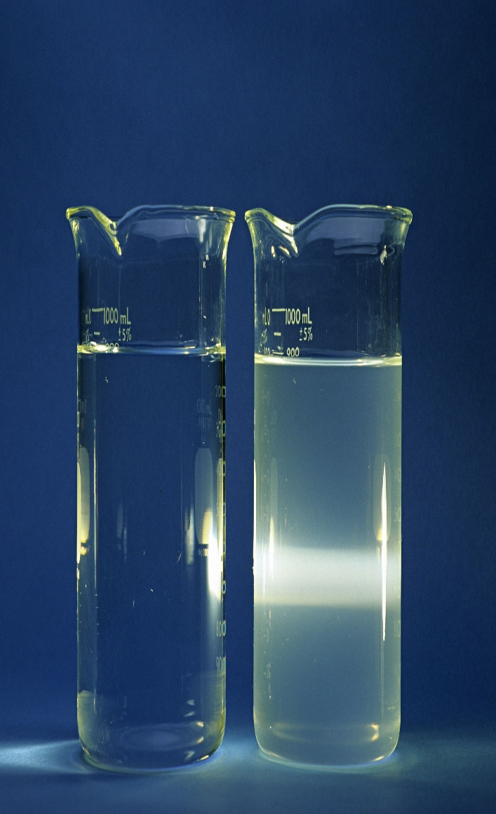
Homogeneous Mixtures
Solution – A HM mixture of particles so small that they cannot be seen with a microscope and will never settle to the bottom of their container.
Exs. – Vinegar, Hydrogen Perioxide
Colloid – A HM mixture with particles that are larger than those in solutions but are not heavy enough to settle out.
Exs. – Milk, Paint
How to tell a solution from a colloid? A solution is see-through, a colloid is not and will scatter light. This is called the Tyndall Effect.

Slide 5
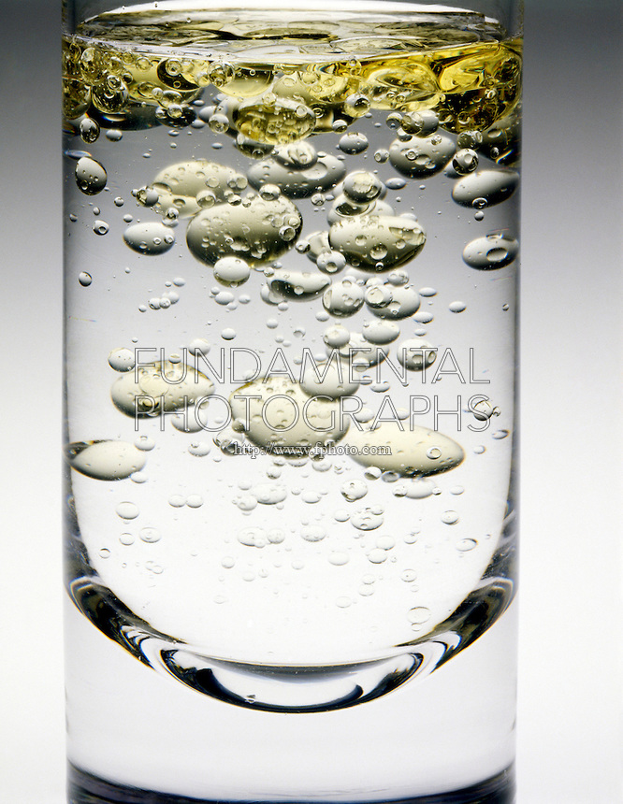
Heterogenous Mixtures
Suspension - A HT mixture containing liquid in which visible particles separate.
Exs. Muddy water, oil and vinegar

